Slide 1


Bacterial group
Lecture 3
Prof. Dr. Munira Ch. Ismaeel
Ass. Prof. Dr. Israa AJ Ibrahim

Slide 2

Bacterial group Lec.3
Prof. Dr. Munira Ch. Ismaeel and Ass. Prof. Dr. Israa AJ Ibrahim

Slide 3
Classification of Bacteria
Bergey’s manual: Manual is in lab for a reference when doing unknown
Developed on 1940’s for grouping bacteria according to standard diagnostic lab techniques available at the time (such as Grams stain)

Slide 4
The manual divides bacteria into 4 groups or divisions on the basis of their Cell Wall:
1- Gram + (stain violet)
2- Gram - (de-stain, and are counterstained pink or reddish color).
3- Bacteria that lack a cell wall (mycoplasma).
4- Organisms that have a cell wall lacking “peptidoglycan” (archaeobacteria – Now called “Archaea”).

Slide 5
More modern methods now used:
. DNA studies, genomics, gene probes
2. Using Bacterial viruses “bacteriophages”
3. Serology – antibody – antigen reactions (like blood typing)
Examples: Salmonella typhi
Salmonella typhimurium
E. coli 0157H7 strain

Slide 6
Why staining?
Bacterial cells are usually colorless because cytoplasm, for the most part, is transparent. Since the bacteria are colorless, it is almost essential to add a stain to make the bacteria more visible. Once stained, cell morphology can be observed.

Slide 7
Different Size, Shape and Arrangement of Bacterial Cells
The cell structure is simpler than that of other organisms as there is no nucleus or membrane bound organelles.
Due to the presence of a rigid cell wall, bacteria maintain a definite shape, though they vary as shape, size and structure

Slide 8
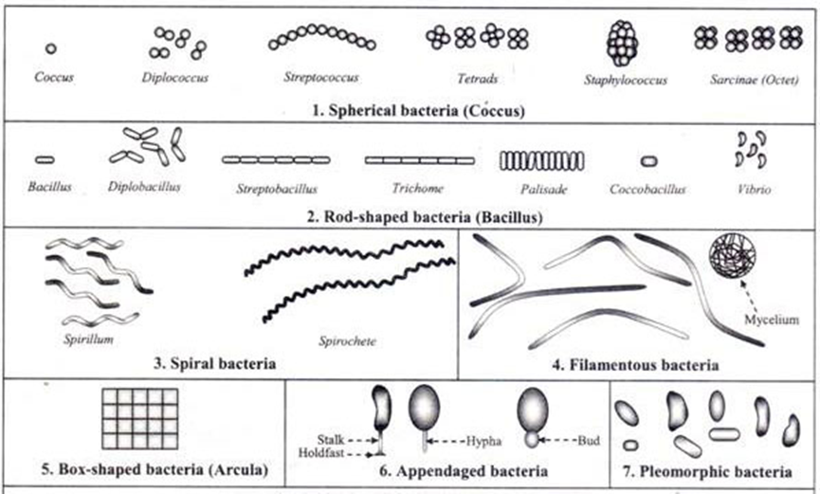
When viewed under light microscope, most bacteria appear in variations of three major shapes: the rod (bacillus), the sphere (coccus) and the spiral type (vibrio).

Slide 9
Bacteria can also have different arrangements of cells:
Diplo - cells remain in pairs after dividing.
Strepto - cells remain in chains after dividing.
Tetrad - cells remain in groups of four and divide in two planes.
Sarcinae - cells remain in groups of eight and divide in three planes.
Staphylo - cells remain in clusters and divide in multiple planes

Slide 10
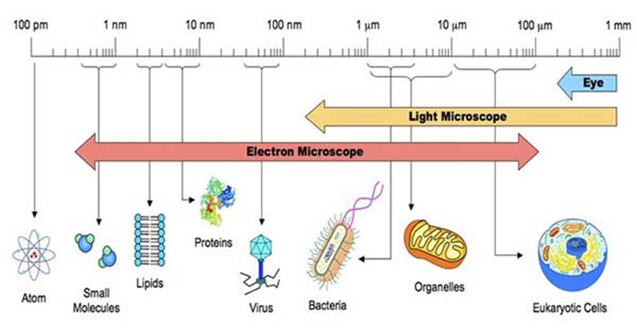
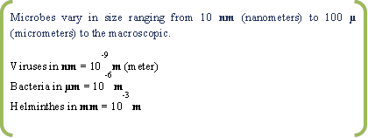
Size of Bacterial Cell

Slide 11
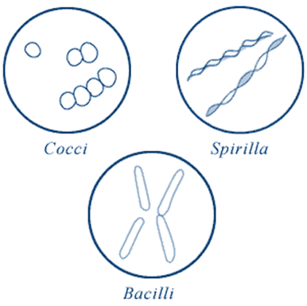
Shape of Bacterial Cell
Cocci (or coccus for a single cell) are round cells, sometimes slightly flattened when they are adjacent to one another.
Bacilli (or bacillus for a single cell) are rod-shaped bacteria.
Spirilla (or spirillum for a single cell) are curved bacteria which can range from a gently curved shape to a corkscrew-like spiral.

Slide 12
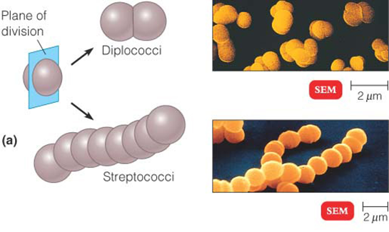
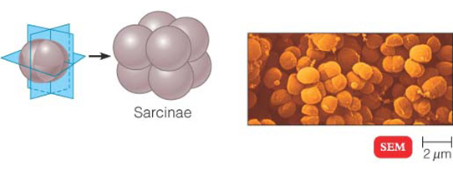
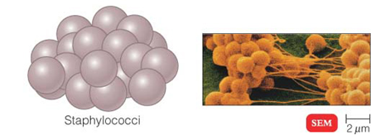
Arrangement of Cocci
1.Diplococci
2. Streptococci
3. Tetrads
4. Sarcinae
5. Staphylococci

Slide 13
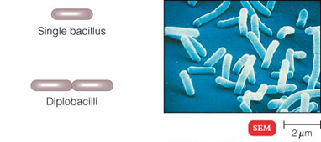
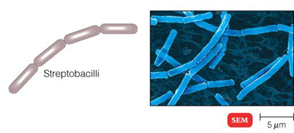
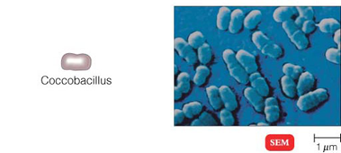
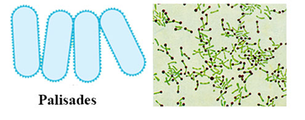
Arrangement of Bacilli
1. Diplobacilli
2. Streptobacilli
3. Coccobacilli
4. Palisades

Slide 14
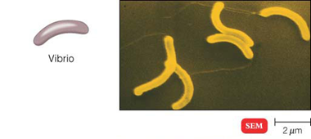
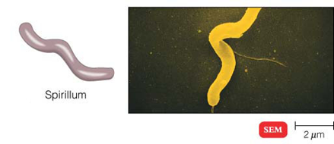
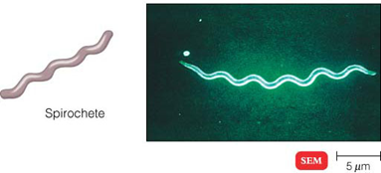
Arrangement of Spiral Bacteria
1. Vibrio
2. Spirilla
3. Spirochetes

Slide 15
Others Shapes and Arrangements of Bacteria
1. Filamentous Bacteria
2. Star Shaped Bacteria
3. Rectangular Bacteria
4. Pleomorphic Bacteria

